Slide 1
Bayesian Optimization and Deep learning

Slide 2



Goals and decisions
Goal?
Exploration
Exploitation
Exploration and Exploitation !

Slide 3
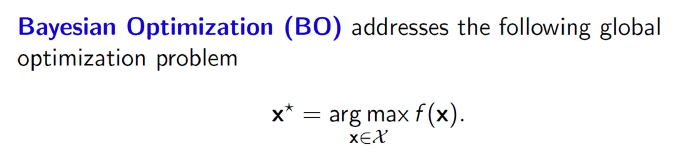
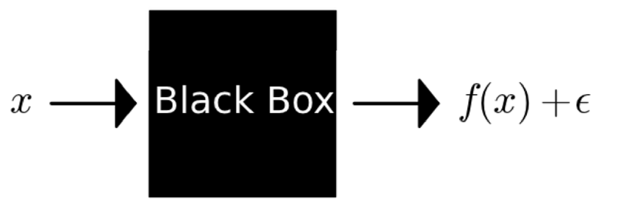
Bayesian Optimization
All we can do is,

Slide 4
Recall Gradient Descent

Slide 5
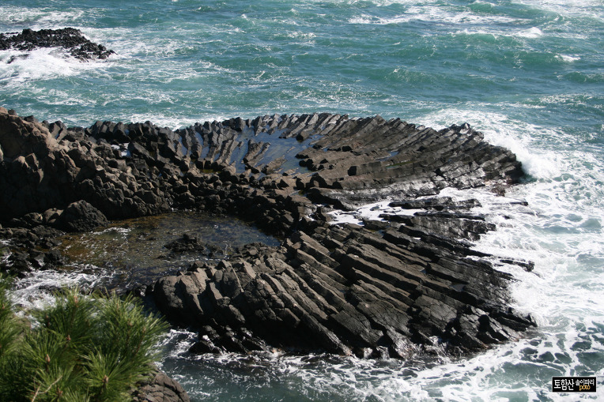
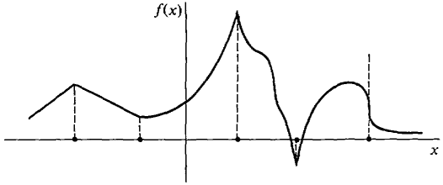
Why not use them?

Slide 6
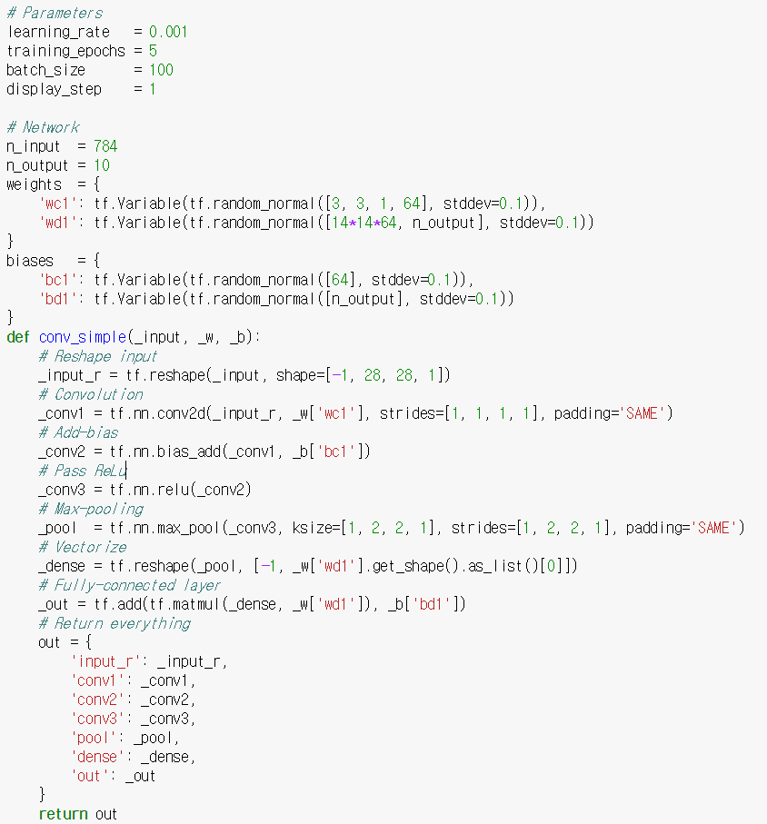
For example?
Hyper-parameters!

Slide 7
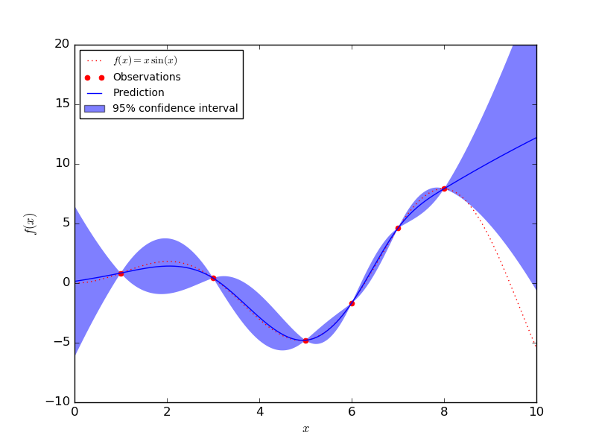
Bayesian Optimization
Uses Gaussian process regression (GPR) to model an unknown function

Slide 8
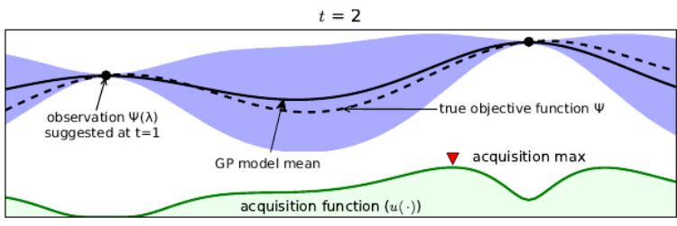
Acquisition Function
Measures the expected benefits of evaluating the objective function at a certain point
Exploration and Exploitation trade-off

Slide 9
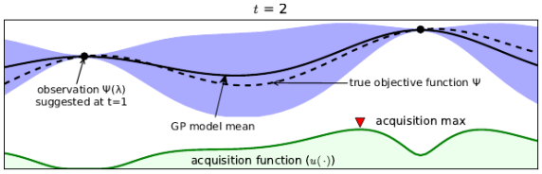
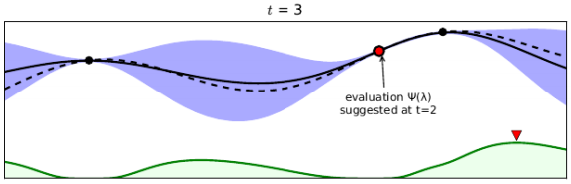
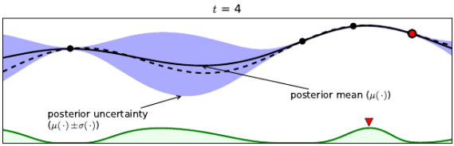
Acquisition Function

Slide 10
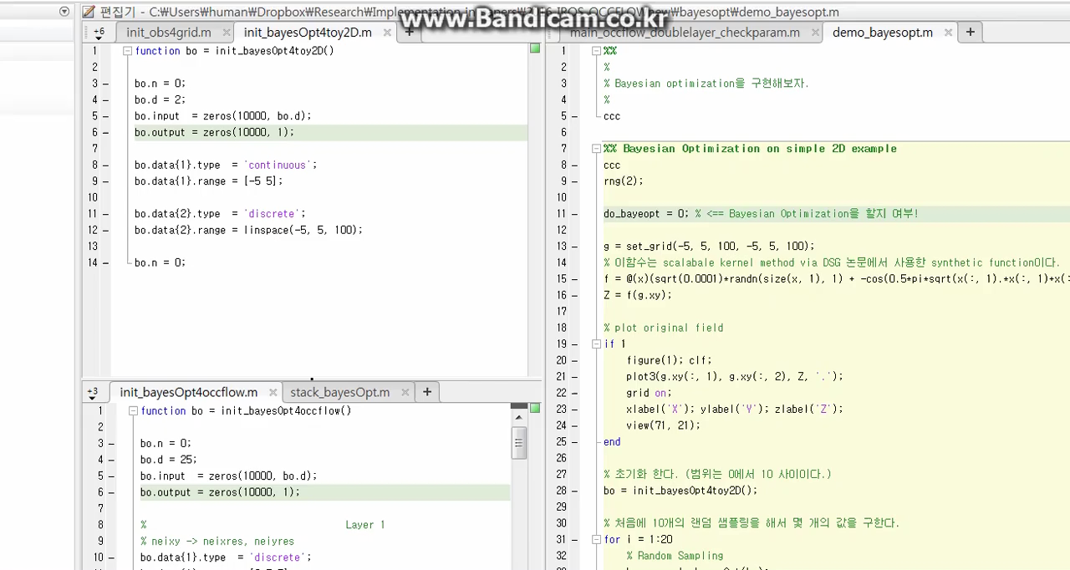
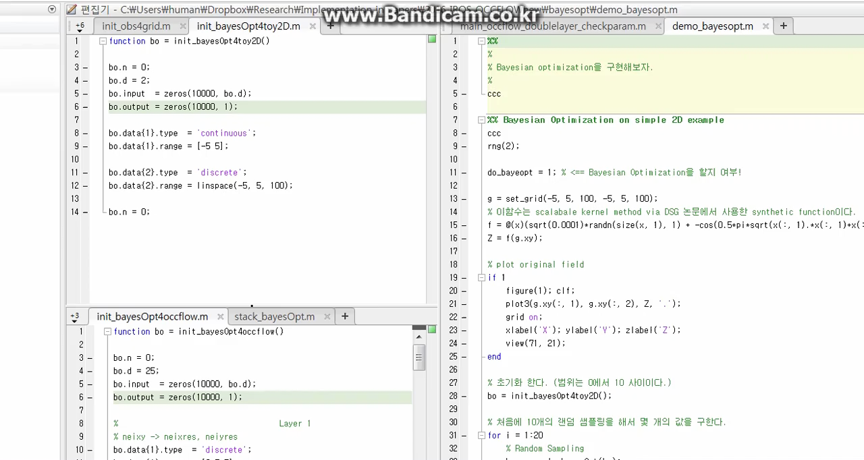
Bayesian Optimization
Random Sampling
Bayesian Optimization

Slide 11

Bayesian Optimization on CNN
The parameters we explore include 1) the number of epochs to run the model, 2) the learning rate, 3) four weight costs (one for each layer and the SoftMax output weights), and 4) the width, scale and power of the response normalization on the pooling layers of the network.
18%
14.98%

